Slide 1
The call number in the holdings record and the call number in the item record
Yoel Kortick. Senior Librarian

Slide 2


Introduction
The call number in the holdings record
Fields where the call number may be catalogued
Call number appearance to staff and end user
Retrieving by holdings call number and item call number
When and why is it recommended to use an item call number
Holdings call number and item call number in published xml
Holdings call number and item call number in API output

Slide 3
Introduction

Slide 4
Introduction
This presentation will explain
  The difference between the holdings record call number and the item call number
  State when it may be appropriate to use the item call number in addition to the holdings record call number
We will also show where and how the call number, from both the holdings record and item, appears and may be retrieved via Alma and Primo.

Slide 5
The call number in the holdings record

Slide 6
The call number in the holdings record
In Alma there is one holdings record per bibliographic record for each unique combination of
  Library (852 $$b)
  Location (852 $$c)
  Classification Call Number (852 $$h)
  Item Part (852 $$i)
  Classification Call Number Prefix (852 $$k)
  Classification Call Number Suffix (852 $$m)
  Copy Number (852 $$t)
The above values are case sensitive

Slide 7
The call number in the holdings record
For example one bibliographic record cannot have two holdings records as follows:
$$b ULINC $$c GEN $$h PS3573.I87 $$i G74 1991 $$k Ref $$m Vault $$t 613
$$b ULINC $$c GEN $$h PS3573.I87 $$i G74 1991 $$k Ref $$m Vault $$t 613

Slide 8
The call number in the holdings record
One bibliographic record cannot have two holdings records as follows:
$$b ULINC $$c GEN $$h PS3573.I87
$$b ULINC $$c GEN $$h PS3573.I87

Slide 9
The call number in the holdings record
One bibliographic record can have two holdings records as follows:
$$b ULINC $$c GEN $$h PS3573.I87 $$i G74 1991 $$k Ref $$m Vault $$t 613
$$b ULINC $$c GEN $$h PS3573.I87 $$i G74 1991 $$k Ref $$m Vault $$t 614

Slide 10
The call number in the holdings record
One bibliographic record can have two holdings records as follows:
$$b ULINC $$c GEN $$h PS3573.I87 $$i G74 1991 $$k Ref $$m Vault $$t 613
$$b ULINC $$c GEN $$h PS3573.I87 $$i G74 1991 $$k REF $$m Vault $$t 613

Slide 11
Fields where the call number may be catalogued

Slide 12
Fields where the call number may be catalogued
In Alma the call number of an item is “catalogued” (or “entered”) into one or both of the following fields:
852 subfield h, i, k, m of the holdings record
Item call number field of the item

Slide 13
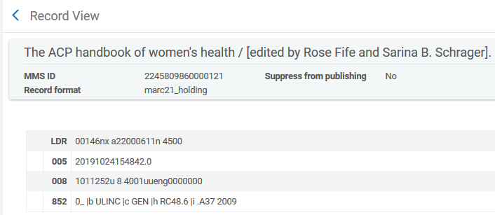
Fields where the call number may be catalogued
852 subfield h, i, k, m of the holdings record

Slide 14
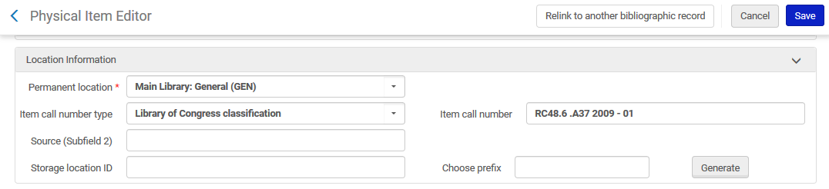
Fields where the call number may be catalogued
Item call number field of the item

Slide 15
Call number appearance to staff and end user

Slide 16
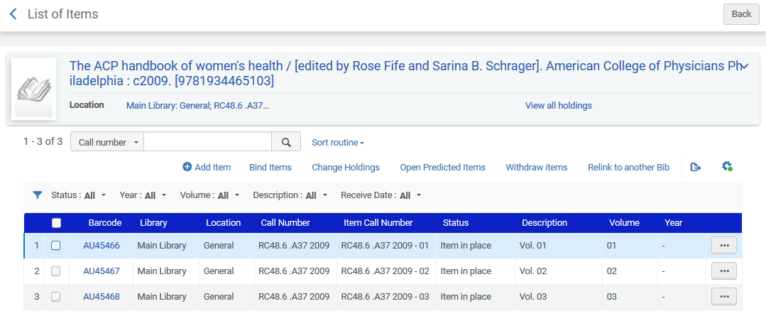
Call number appearance to staff and end user
Alma list of items
From Holdings Record
From Item Record

Slide 17
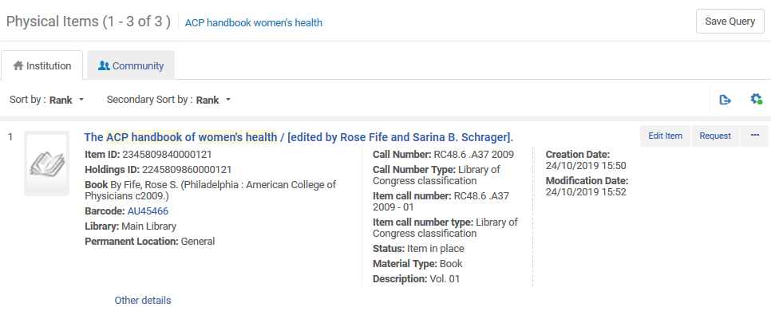
Call number appearance to staff and end user
Alma physical items search results
From Holdings Record
From Item Record

Slide 18
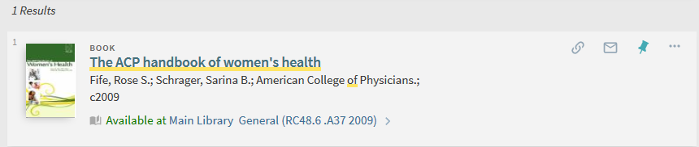
Call number appearance to staff and end user
Primo search results
From Holdings Record

Slide 19
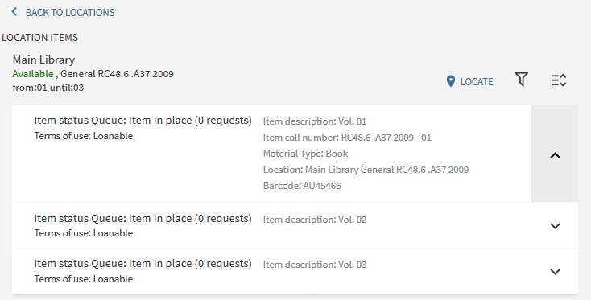
Call number appearance to staff and end user
Primo GetIt tab
From Item Record
From Holdings Record

Slide 20
Retrieving by holdings call number and item call number

Slide 21
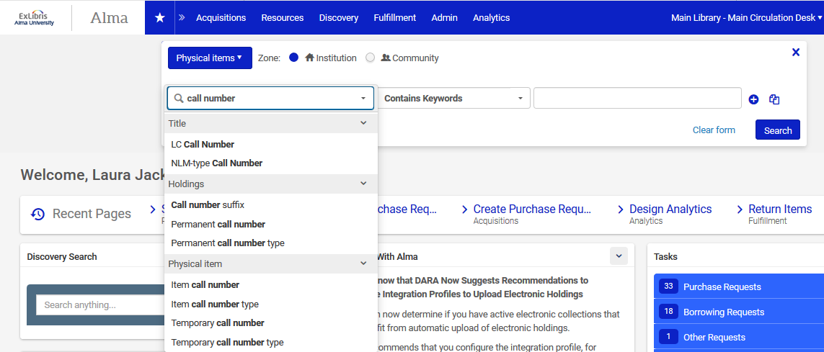
Retrieving by holdings call number and item call number
Staff user retrieval in Alma

Slide 22
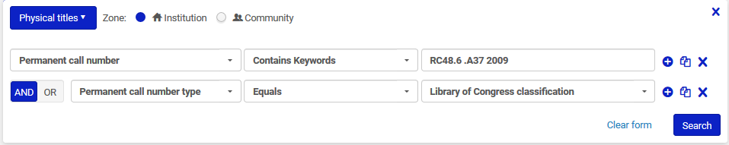
Retrieving by holdings call number and item call number
Here in Alma we retrieve physical titles by holding record call number (permanent call number) “RC48.6 .A37 2009” and call number type (from 852 1st indicator) “Library of Congress Classification”
Staff user retrieval in Alma

Slide 23
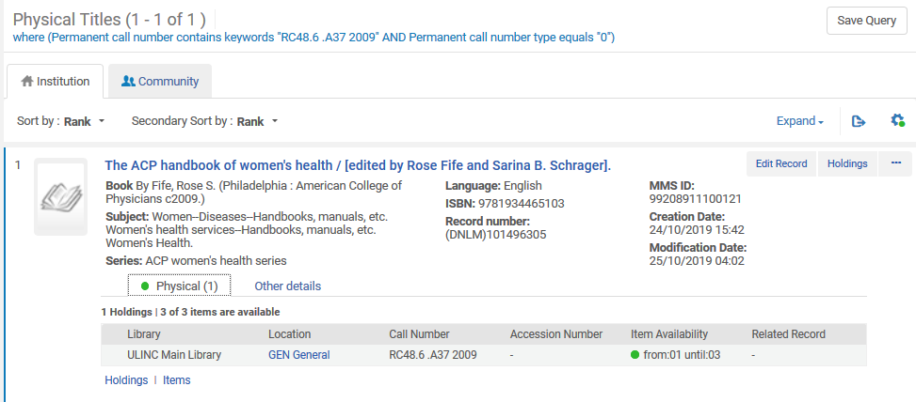
Retrieving by holdings call number and item call number
Staff user retrieval in Alma
This record is retrieved

Slide 24
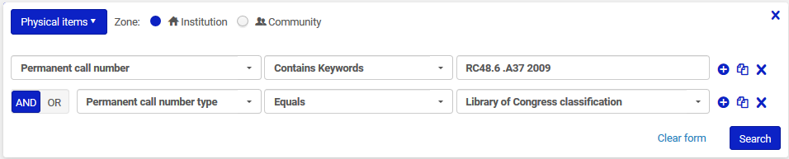
Retrieving by holdings call number and item call number
Here in Alma we retrieve physical items by holding record call number (permanent call number) “RC48.6 .A37 2009” and call number type (from 852 1st indicator) “Library of Congress Classification”
Staff user retrieval in Alma

Slide 25
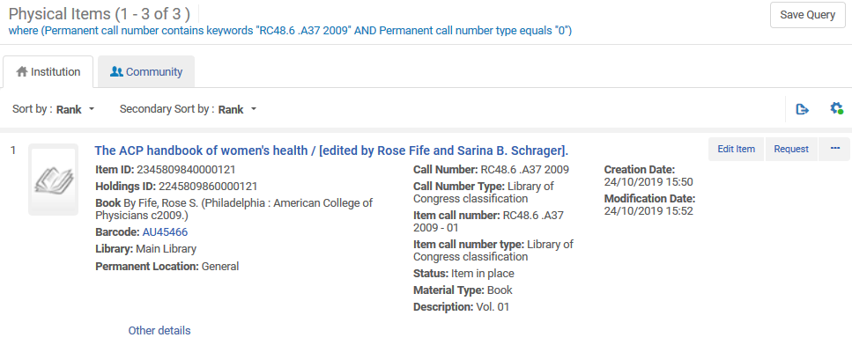
Retrieving by holdings call number and item call number
Staff user retrieval in Alma
All items connected to the holding record are retrieved

Slide 26
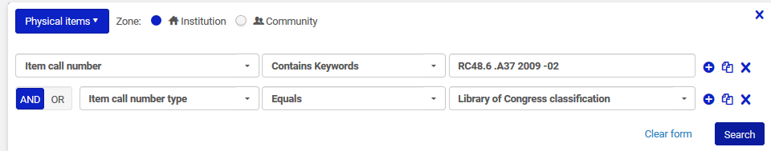
Retrieving by holdings call number and item call number
Here in Alma we retrieve physical items by item call number “RC48.6 .A37 2009 - 02” and item call number type “Library of Congress Classification”
Staff user retrieval in Alma

Slide 27
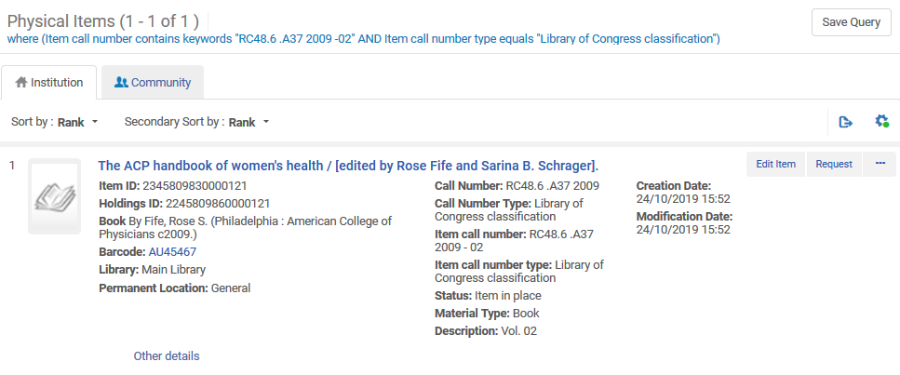
Retrieving by holdings call number and item call number
Staff user retrieval in Alma
We retrieve the specific item which has the specific item call number

Slide 28
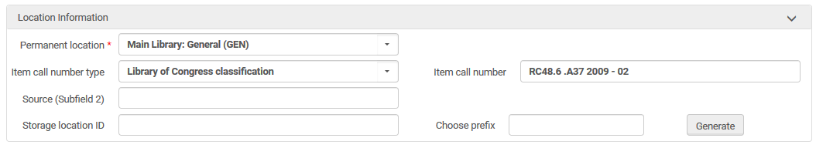
Retrieving by holdings call number and item call number
We see that the retrieved item has item call number “RC48.6 .A37 2009 - 02” and item call number type “Library of Congress Classification”
Staff user retrieval in Alma

Slide 29
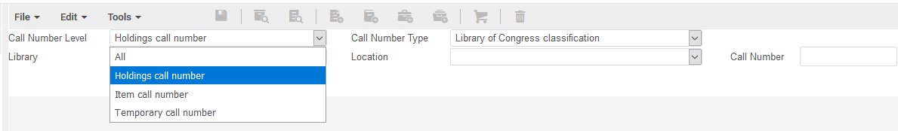
Retrieving by holdings call number and item call number
In Alma it is possible to browse shelf listing by both the holdings record call number and the item call number
Staff user retrieval in Alma

Slide 30
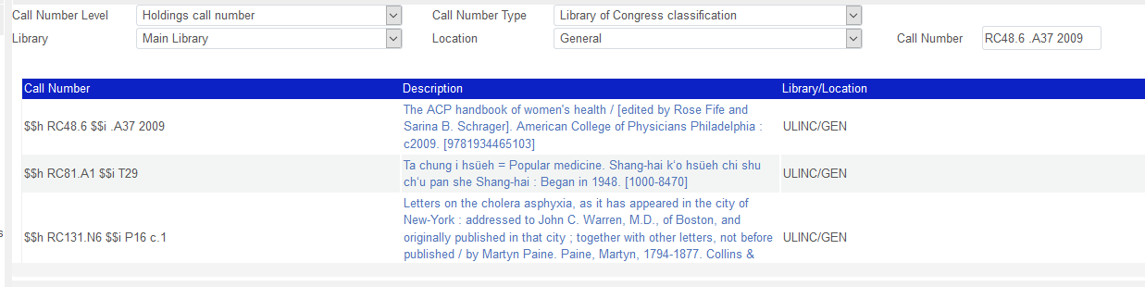
Retrieving by holdings call number and item call number
Browse shelf listing by holdings record call number
Staff user retrieval in Alma

Slide 31
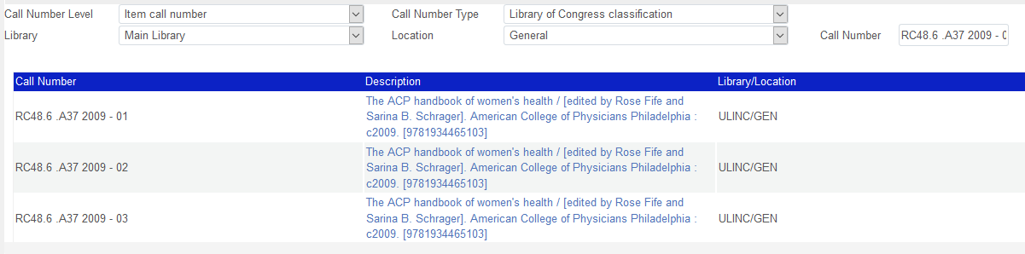
Retrieving by holdings call number and item call number
Browse shelf listing by item call number
Staff user retrieval in Alma

Slide 32
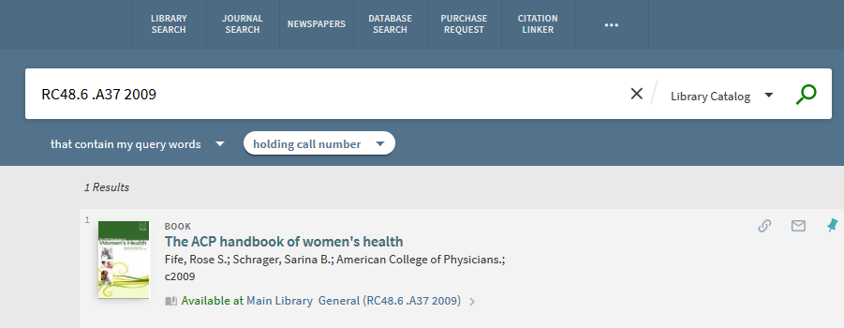
Retrieving by holdings call number and item call number
In Primo the end user can search by the holdings record call number

Slide 33
When and why is it recommended to use an item call number

Slide 34
When and why is it recommended to use an item call number
Before answering the question “When and why is it recommended to use an item call number?” let’s look at two examples.
The examples will already lead us into the answer.

Slide 35

When and why is it recommended to use an item call number
Example one is title “The ACP handbook of women’s health”.
Each of the three physical volumes has a different call number:
  RC48.6 .A37 2009 – 01
  RC48.6 .A37 2009 – 02
  RC48.6 .A37 2009 – 03
There is one holdings record and it has call number RC48.6 .A37 2009
The separate call numbers of each volume have been put into the item call number of each item

Slide 36
When and why is it recommended to use an item call number
Example two is title “Oxford handbook of women and gender in medieval Europe”.
Each of the three physical volumes has a different call number:
  HQ1143.O94 2013 – 01
  HQ1143.O94 2013 – 02
  HQ1143.O94 2013 – 03
There are three holdings records: one for each item.
Each item does not have an item call number because each item has it’s own dedicated holdings record with its own unique call number.
The separate call numbers of each volume have been put into the specific holdings record dedicated to the item.

Slide 37
When and why is it recommended to use an item call number
We recommend to work like example one.
Use one holdings record when there are multiple items in the same library and location and the call numbers differ only slightly (have the same basis) then use the item call number field in the item to distinguish between them.
Example one is
  Easier maintenance for staff.
  Easier access for end user in discovery, both from Primo and via a published file. There are less clicks back and forth in and out of holdings records

Slide 38
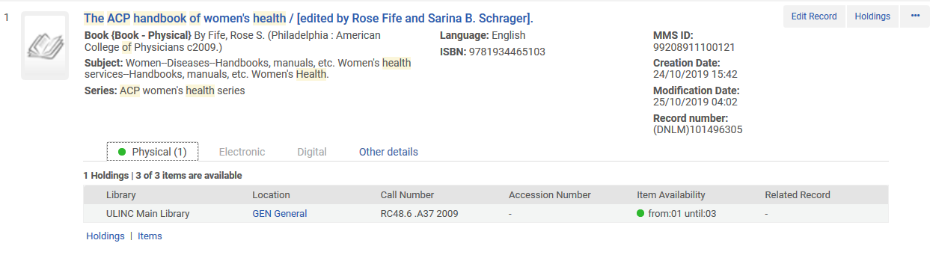
When and why is it recommended to use an item call number
Here is “The ACP handbook of women’s health”. One holdings record for all three items.

Slide 39
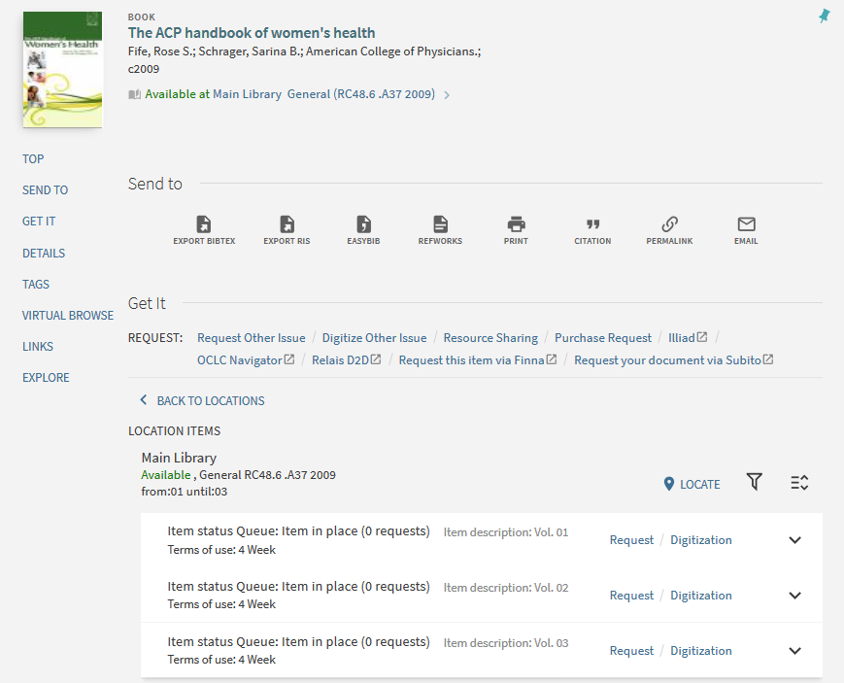
When and why is it recommended to use an item call number
In the Primo GetIt tab there is one link to all three items

Slide 40
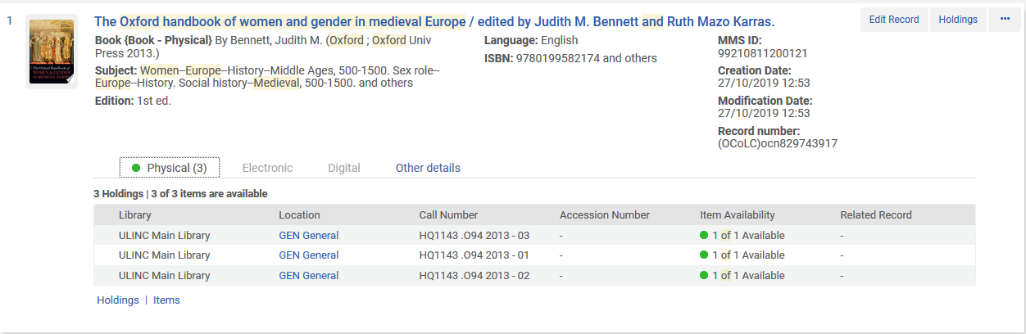
When and why is it recommended to use an item call number
Here is “The Oxford handbook of women and gender in medieval Europe”. Each item with it’s own holdings record.

Slide 41
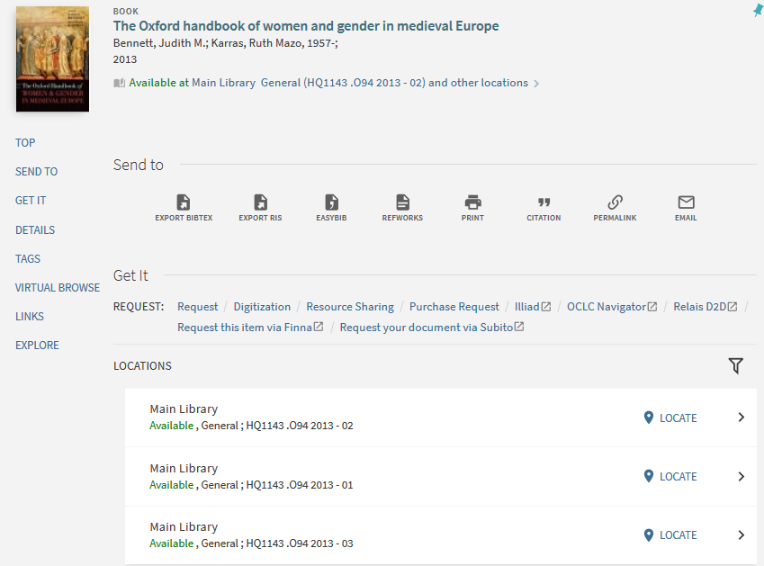
When and why is it recommended to use an item call number
In the Primo GetIt tab there are three separate links – one for each item

Slide 42
Holdings call number and item call number in published xml

Slide 43
Holdings call number and item call number in published xml
When publishing via the general publishing profile both the holdings call number and item call number are published in the xml.
Thus if using the publishing file for a discovery interface the call number will appear, regardless of where it is in Alma.

Slide 44
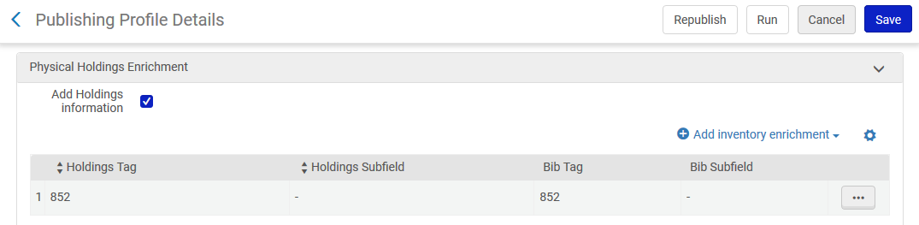
Holdings call number and item call number in published xml
Here we define to bring the entire 852 field from the holdings record and “expand” it into the bibliographic record. It is also possible to define that only certain subfields will be “expanded”, and also to send them to a bibliographic field other than 852.

Slide 45
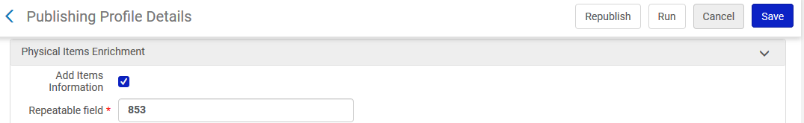
Holdings call number and item call number in published xml
Here we define that the item call number will be “expanded” to the 853 field of the bibliographic record and go into subfield h

Slide 46
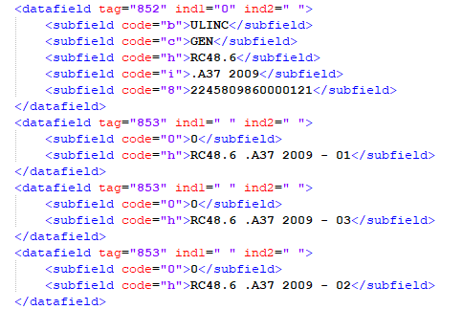
Holdings call number and item call number in published xml
For title “The ACP handbook of women's health” the one holdings record 852 field and three item call numbers appear

Slide 47
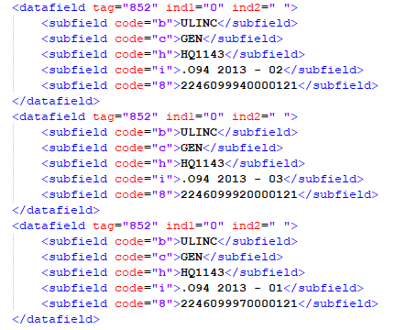
Holdings call number and item call number in published xml
For title “The Oxford handbook of women and gender in medieval Europe” all three holdings records 852 fields appear

Slide 48
Holdings call number and item call number in API output

Slide 49
Holdings call number and item call number in API output
When doing a GET via the API both the holdings call number and item call number appear in the output.
Thus if using the APIs for a discovery interface the call number will appear, regardless of where it is in Alma.

Slide 50
Holdings call number and item call number in API output
Here is the API syntax to get the holdings record for title “The ACP handbook of women's health”
https://api-eu.hosted.exlibrisgroup.com/almaws/v1/bibs/99208911100121/holdings/2245809860000121?apikey=613l7xxb1e0a1a10fdb4665ae8ae86a361eb6a5

Slide 51
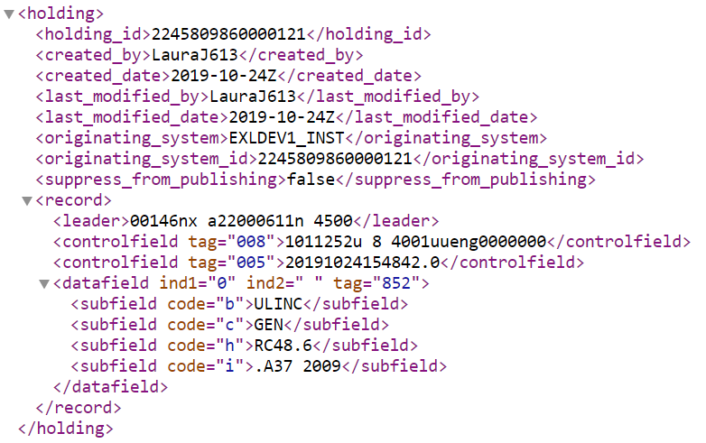
Holdings call number and item call number in API output
The full holdings record with the call number appears

Slide 52
Holdings call number and item call number in API output
Here is API syntax to get the items for title “The ACP handbook of women's health”
https://api-eu.hosted.exlibrisgroup.com/almaws/v1/bibs/99208911100121/holdings/2245809860000121/items/2345809840000121?view=brief&apikey=613l7xxb1e0a1a10fdb4665ae8ae86a361eb6a5
https://api-eu.hosted.exlibrisgroup.com/almaws/v1/bibs/99208911100121/holdings/2245809860000121/items/2345809830000121?view=brief&apikey=613l7xxb1e0a1a10fdb4665ae8ae86a361eb6a5
https://api-eu.hosted.exlibrisgroup.com/almaws/v1/bibs/99208911100121/holdings/2245809860000121/items/2345809820000121?view=brief&apikey=613l7xxb1e0a1a10fdb4665ae8ae86a361eb6a5

Slide 53
Holdings call number and item call number in API output
And the results show the item call number

Slide 54
Yoel.Kortick@exlibrisgroup.com

